Slide 1

IST-659 Final Project
SU Marketplace and Collaborative Platform
Eric Lee
Anish Kumar
Komal Sharma

Slide 2

Project Overview
Welcome to SU Marketplace and Collaborative Platform!!
A visionary platform reshaping the fabric of Syracuse University's communal spirit. Beyond a mere marketplace, this dynamic space unites students and faculty in a synergistic exchange where intellectual collaboration seamlessly intertwines with the buying and selling of products at accessible prices.
Rooted in innovation, our project is a testament to the intellectual marketplace that is Syracuse University, fostering a harmonious blend of academic collaboration and economical exchange.

Slide 3
Idea Behind the Project!!!
At the heart of our project lies the vision to create a dynamic and interconnected space within Syracuse University. By integrating collaborative spaces and a cost-effective marketplace, our project aims to nurture a thriving ecosystem where students and faculty can not only engage intellectually but also easily buy and sell essential products. The fusion of academic collaboration and economical exchange is the essence of our endeavor, promising to redefine the university experience and foster a sense of community and shared growth."

Slide 4

Goals
Seamless Collaboration: Foster effortless collaboration among students and faculty through an intuitive platform , cultivating a sense of community and shared knowledge.
Affordable Marketplace: Establish a marketplace for buying and selling products at affordable prices, catering to the unique needs of Syracuse University students and faculty.
Enhanced Connectivity: Improve connectivity within the university community by providing a centralized hub for intellectual engagement, resource exchange, and cost-effective transactions.
Streamlined Transactions: Implement a user-friendly system for buying and selling, ensuring a smooth and secure transaction process to enhance the overall user experience.

Slide 5

Specifications
Entity Relationship Diagram
Conceptual Data Model
Logical Data Model
SQL/Up/Down Script to create/drop tables, keys constraints*
User Stories
External data model satisfying user stories
Triggers/Procedures
User Interface Design

Slide 6
Data Requirements

Slide 7

Conceptual Model

Slide 8
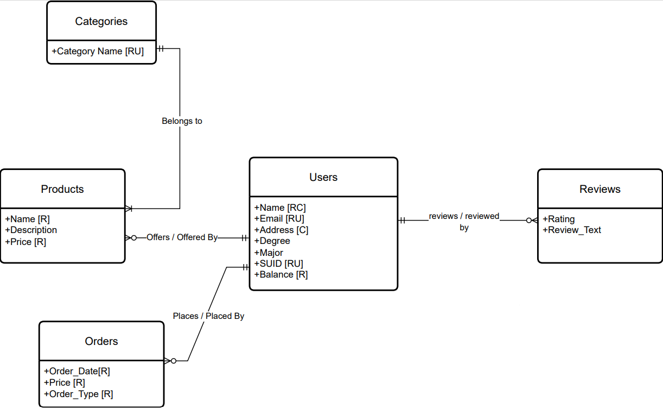

Slide 9
Logical Model

Slide 10
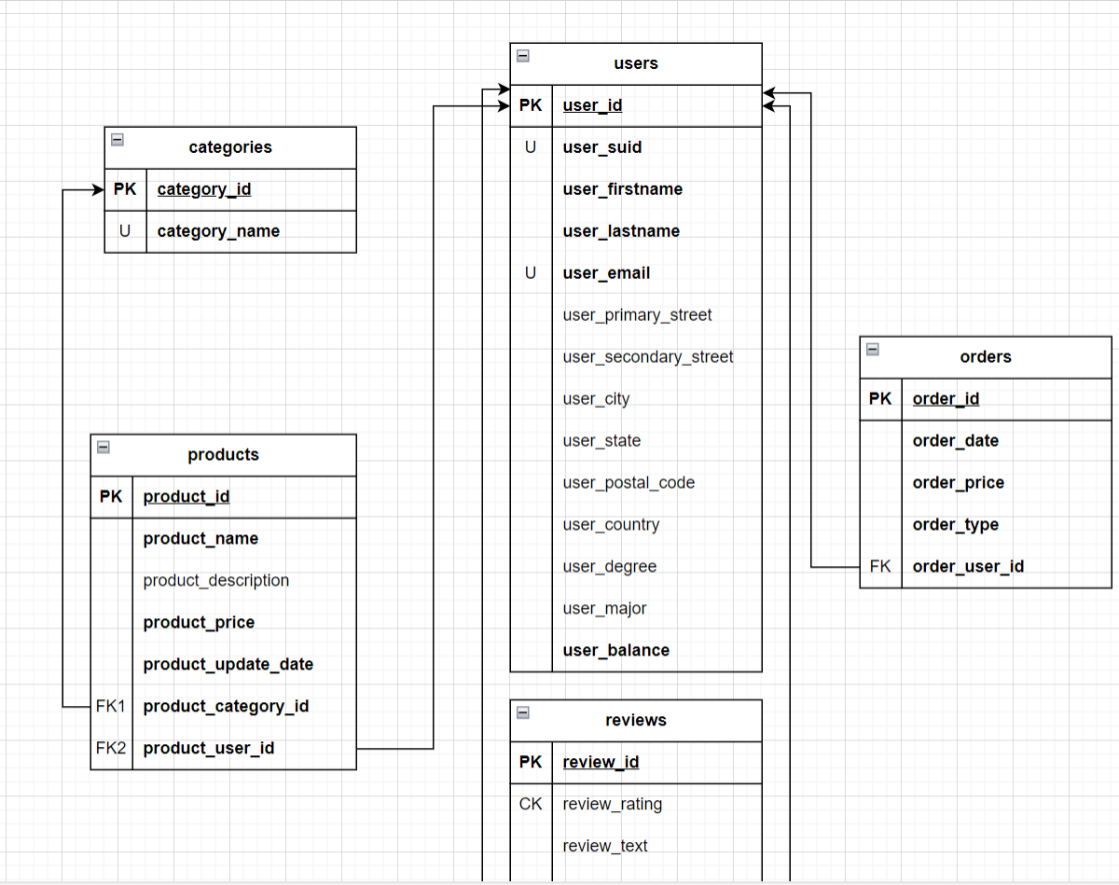

Slide 11
Demonstration

Slide 12
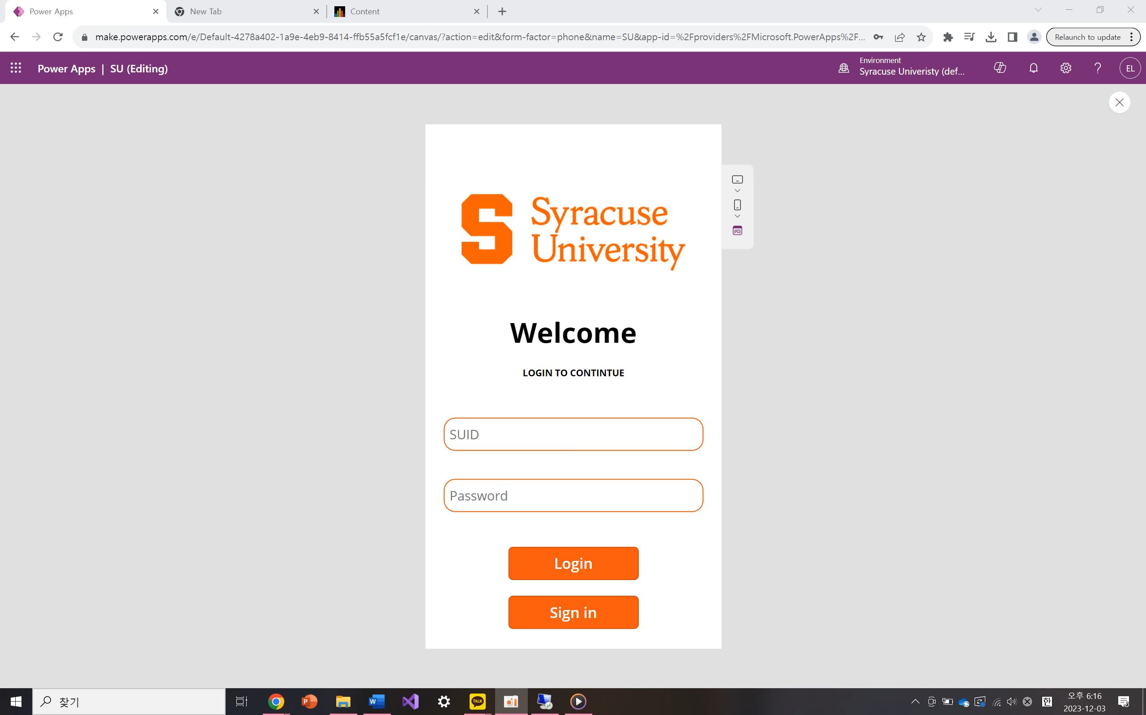

Slide 13
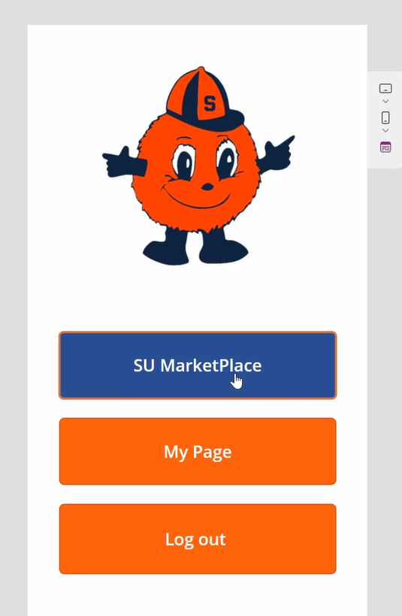
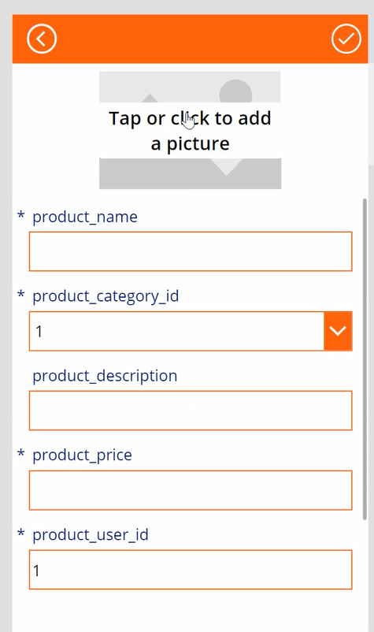
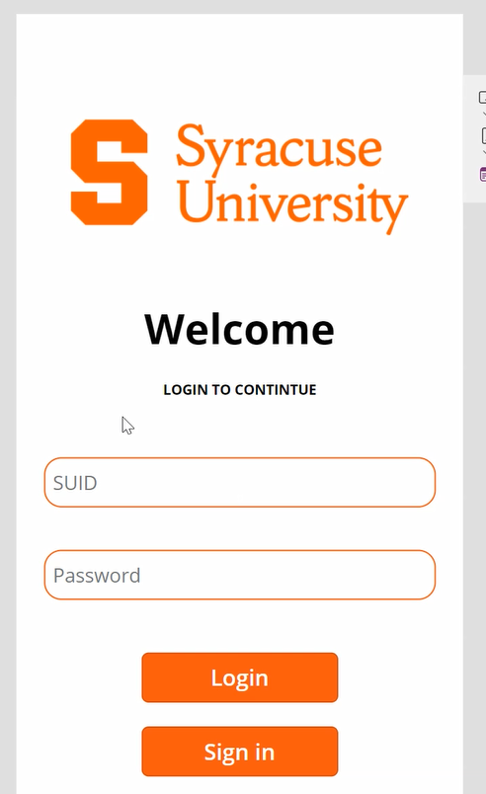
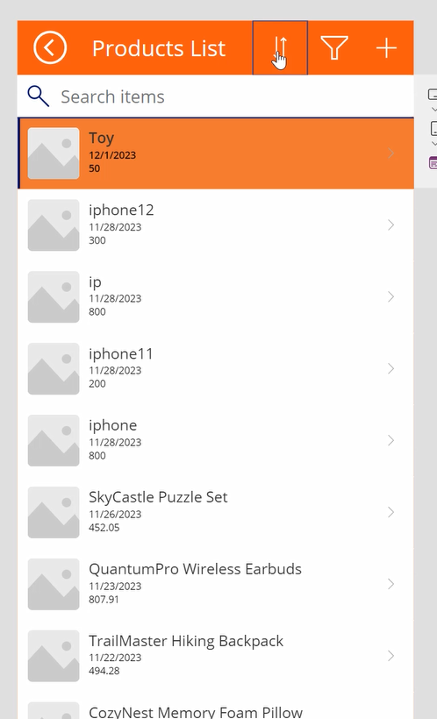
Logical Design of UI Layout

Slide 14
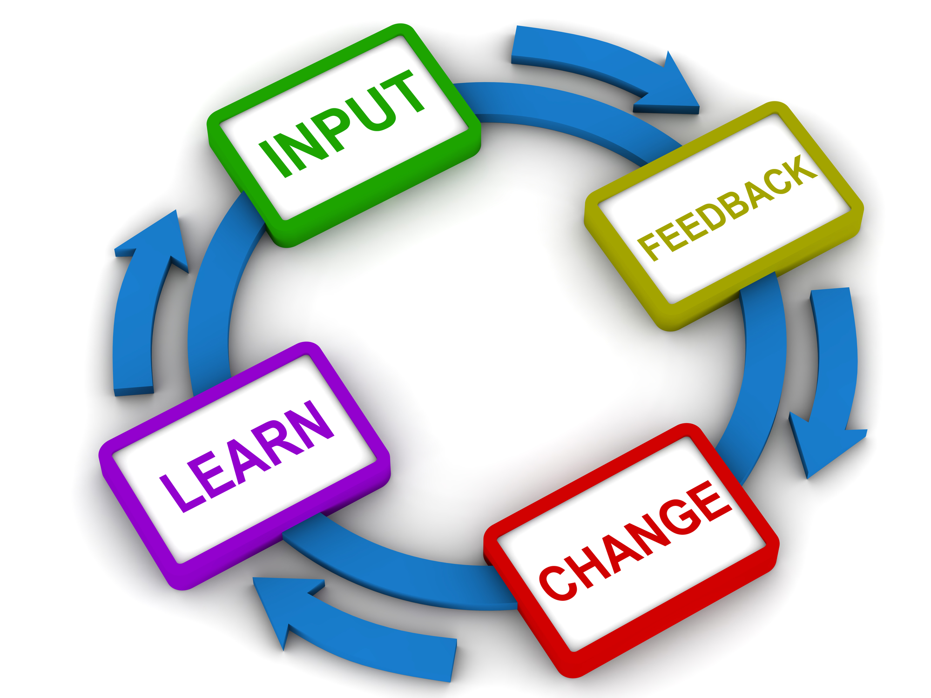
Area of Improvements
User Experience (UX): Collect user feedback for iterative design improvements. Ensure a seamless and enjoyable user experience.
Marketplace Functionality: Enhance search and filtering for improved product discovery. Strengthen security measures for secure transactions.
Collaborative Spaces: Expand features in collaborative spaces for advanced project management. Implement a robust notification system for project updates.
Communication Tools: Explore real-time communication features for instant interactions. Consider adding group messaging capabilities.
Mobile Responsiveness: Ensure consistent/optimal experiences across devices. Prioritize mobile design enhancements based on user preferences.

Slide 15

Challenges
Technical Complexity:
Challenge: Navigating the technical intricacies of developing a collaborative platform with integrated marketplace features.
Mitigation: Engaged experienced developers, conducted thorough research, and leveraged proven technologies to address technical complexities.
User Requirements Understanding:
Challenge: Gaining a deep understanding of the diverse requirements of students and faculty for both collaborative spaces and a marketplace.
Mitigation: Conducted user interviews, surveys, and involved potential users in the design and testing process to gather valuable insights.
Integration with University Systems:
Challenge: Overcoming challenges in integrating the platform with existing university systems and databases.
Mitigation: Collaborated closely with university IT teams, allocated sufficient time for integration testing, and addressed compatibility issues promptly.
Data Security Measures:
Challenge: Implementing robust data security measures to protect sensitive user information.
Mitigation: Prioritized data security from the project's outset, conducted regular security audits, and ensured compliance with relevant data protection regulations.

Slide 16

Thank You!
Any Questions?

